Slide 1
Chapter 3:
Operating Systems
Computer Science: An Overview
Eleventh Edition
by
J. Glenn Brookshear

Slide 2
Chapter 3: Operating Systems
3.1 The History of Operating Systems
3.2 Operating System Architecture
3.3 Coordinating the Machine’s Activities
3.4 Handling Competition Among Processes
3.5 Security
0-<number>

Slide 3
Operating Systems
An operating system is the software that controls the overall operation of a computer.
It provides the means by which a user can store and retrieve files, provides the interface by which a user can request the execution of programs, and provides the environment necessary to execute the programs requested.
0-<number>

Slide 4
Operating Systems
Windows is provided in numerous versions by Microsoft and widely used in the PC arena.
UNIX is a popular choice for larger computer systems as well as PCs. In fact, UNIX is the core of two other popular operating systems:
Mac OS provided by Apple for its range of Mac machines, and
Solaris developed by Sun Microsystems (now owned by Oracle).
Linux was originally developed noncommercially
0-<number>

Slide 5
Operating Systems
For casual computer users, the differences between operating systems are largely cosmetic.
For computing professionals, different operating systems can represent major changes in the tools they work with or the philosophy they follow in maintaining their work.
0-<number>

Slide 6
Functions of Operating Systems
Oversee operation of computer
Store and retrieve files
Schedule programs for execution
Coordinate the execution of programs
0-<number>

Slide 7
Evolution of Shared Computing
Batch processing
Interactive processing
  Requires real-time processing
Time-sharing/Multitasking
  Implemented by Multiprogramming
Multiprocessor machines
0-<number>

Slide 8
Operating Systems
In batch processing systems, the jobs residing in mass storage wait for execution in a job queue (Figure 3.1).
A queue is a storage organization in which objects (in this case, jobs) are ordered in first-in, first-out (FIFO) fashion.
That is, the objects are removed from the queue in the order in which they arrived.
most operating systems provide for consideration of job priorities. A job waiting in queue can be bumped by a higher-priority job.
0-<number>

Slide 9
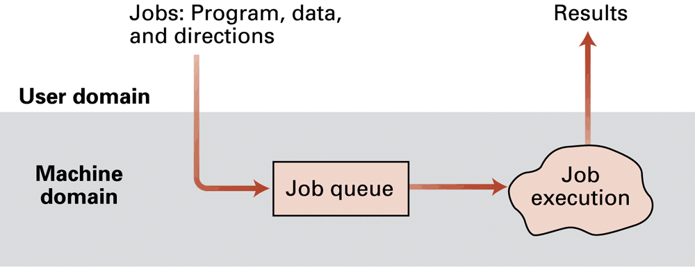
Figure 3.1 Batch processing
0-<number>

Slide 10
Operating Systems
operating systems that allowed a program being executed to carry on a dialogue with the user through remote terminals—a feature known as interactive processing (Figure 3.2).
the computer is forced to execute tasks under a deadline, a process that became known as real-time processing in which the actions performed are said to occur in real-time.
That is, to say that a computer performs a task in real time means that the computer performs the task in accordance with deadlines in its environment.
0-<number>

Slide 11
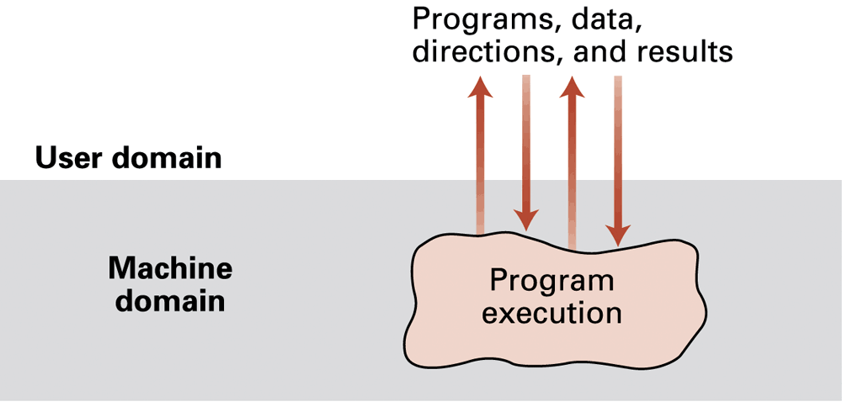
Figure 3.2 Interactive processing
0-<number>

Slide 12
Operating Systems
If the operating system insisted on executing only one job at a time, only one user would receive satisfactory real-time service.
The solution to this problem was to design operating systems that provided service to multiple users at the same time: a feature called time-sharing.
One means of implementing time-sharing is to apply the technique called multiprogramming in which time is divided into intervals and then the execution of each job is restricted to only one interval at a time.
0-<number>

Slide 13
Operating Systems
At the end of each interval, the current job is temporarily set aside and another is allowed to execute during the next interval.
By rapidly shuffling the jobs back and forth in this manner, the illusion of several jobs executing simultaneously is created.
Depending on the types of jobs being executed, early time-sharing systems were able to provide acceptable real-time processing to as many as 30 users simultaneously.
0-<number>

Slide 14
Operating Systems
Today, multiprogramming techniques are used in single-user as well as multiuser systems, although in the former the result is usually called multitasking.
That is, time-sharing refers to multiple users sharing access to a common computer, whereas multitasking refers to one user executing numerous tasks simultaneously.
0-<number>

Slide 15
Operating Systems
The development of multiprocessor machines has led to operating systems that provide time-sharing/multitasking capabilities by assigning different tasks to different processors as well as by sharing the time of each single processor.
These operating systems must wrestle with such problems as load balancing (dynamically allocating tasks to the various processors so that all processors are used efficiently) as well as scaling (breaking tasks into a number of subtasks compatible with the number of processors available).
0-<number>

Slide 16
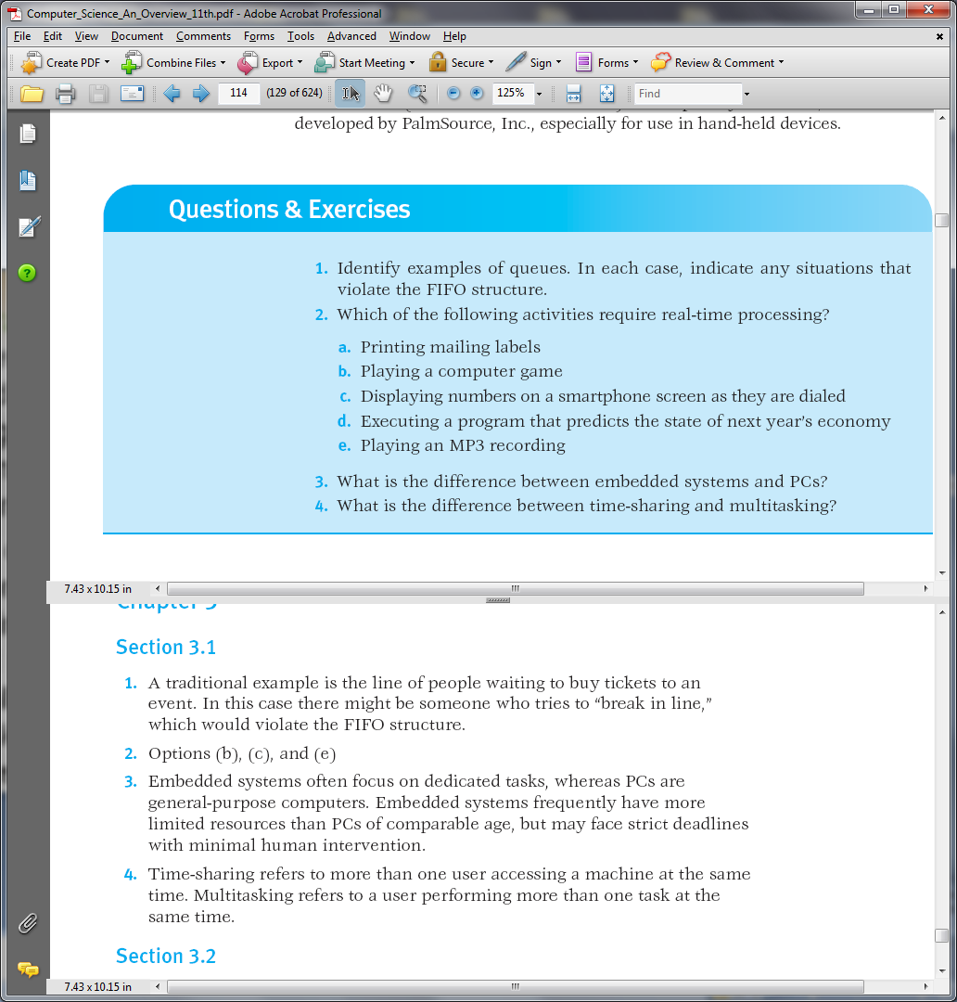
0-<number>

Slide 17
0-<number>

Slide 18
0-<number>

Slide 19
0-<number>

Slide 20
Types of Software
Application software
  Performs specific tasks for users
  spreadsheets, database systems, desktop publishing systems, accounting systems, program development software, and games
System software
  Provides infrastructure for application software
  Consists of operating system and utility software
  instances of utility software include software to compress and decompress data, software for playing multimedia presentations, and software for handling network communication.
0-<number>

Slide 21
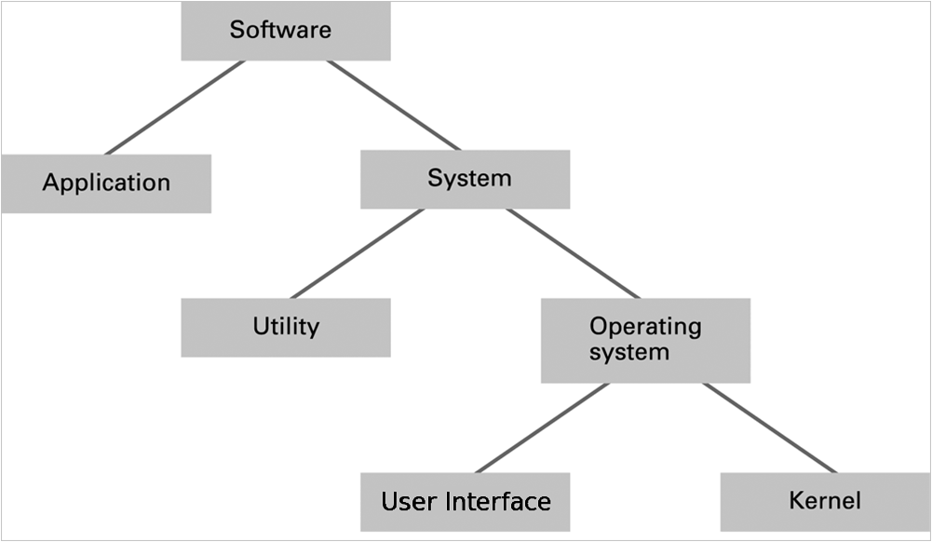
Figure 3.3 Software classification
0-<number>

Slide 22
Operating System Components
User Interface: Communicates with users
  Text based (Shell, textual messages using a keyboard and monitor screen.)
  Graphical user interface (GUI)
Kernel: In contrast to an operating system’s user interface, the internal part of an operating
system is called the kernel. perform the very basic functions required by the computer installation.
  File manager
  Device drivers
  Memory manager
  Scheduler and dispatcher
0-<number>

Slide 23
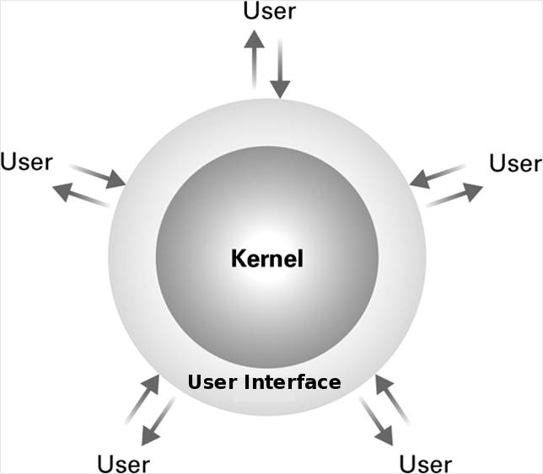
Figure 3.4 The user interface act as an intermediary between users and the operating system kernel
0-<number>

Slide 24
Operating System Components
file manager, whose job is to coordinate the use of the machine’s mass storage facilities. maintains records of all the files stored in mass storage, including where each file is located, which users are allowed to access the various files, and which portions of mass storage are available for new files or extensions to existing files.
device drivers, which are the software units that communicate with the controllers to carry out operations on the peripheral devices attached to the machine. Each device driver is uniquely designed for its particular type of device and translates generic requests into the more technical steps required by the device assigned to that driver.
0-<number>

Slide 25
File Manager
Directory (or Folder): A user-created bundle of files and other directories (subdirectories)
Directory Path: A sequence of directories within directories
0-<number>

Slide 26
Operating System Components
Still another component of an operating system’s kernel is the memory manager, which is charged with the task of coordinating the machine’s use of main memory.
Such duties are minimal in an environment in which a computer is asked to perform only one task at a time. In these cases, the program for performing the current task is placed at a predetermined location in main memory, executed, and then replaced by the program for performing the next task.
0-<number>

Slide 27
Operating System Components
The task of the memory manager is complicated further when the total main memory space required exceeds the space actually available in the computer.
In this case the memory manager may create the illusion of additional memory space by rotating programs and data back and forth between main memory and mass storage (a technique called paging).
Suppose, for example, that a main memory of 8GB is required but the computer only has 4GB.
To create the illusion of the larger memory space, the memory manager reserves 4GB of storage space on a magnetic disk.
0-<number>

Slide 28
Operating System Components
There it records the bit patterns that would be stored in main memory if main memory had an actual capacity of 8GB.
This data is divided into uniform sized units called pages, which are typically a few KB in size.
Then the memory manager shuffles these pages back and forth between main memory and mass storage so that the pages that are needed at any given time are actually present in the 4GB of main memory.
The result is that the computer is able to function as though it actually had 8GB of main memory.
This large “fictional” memory space created by paging is called virtual memory.
0-<number>

Slide 29
Operating System Components
Two additional components within the kernel of an operating system are the scheduler and dispatcher, which we will study in the next section.
For now we merely note that in a multiprogramming system the scheduler determines which activities are to be considered for execution, and the dispatcher controls the allocation of time to these activities.
0-<number>

Slide 30
Getting it Started (Bootstrapping)
how the operating system gets started.
This is accomplished through a procedure known as boot strapping (often shortened to booting) that is performed by a computer each time it is turned on.
It is this procedure that transfers the operating system from mass storage (where it is permanently stored) into main memory (which
is essentially empty when the machine is first turned on).
To understand the boot strap process, we begin by considering the machine’s CPU.
0-<number>

Slide 31
Getting it Started (Bootstrapping)
A CPU is designed so that its program counter starts with a particular predetermined address each time the CPU is turned on.
It is at this location that the CPU expects to find the beginning of the program to be executed. Conceptually, then, all that is needed is to store the operating system at this location.
However, for technical reasons, a computer’s main memory is typically constructed from volatile technologies—meaning that the memory loses the data stored in it when the computer is turned off. Thus, the contents of main memory must be replenished each time the computer is restarted.
0-<number>

Slide 32
Getting it Started (Bootstrapping)
In short, we need a program (preferably the operating system) to be present in main memory when the computer is first turned on, but the computer’s volatile memory is erased each time the machine is turned off.
To resolve this dilemma, a small portion of a computer’s main memory where the CPU expects to find its initial program is constructed from special nonvolatile memory cells.
Such memory is known as read-only memory (ROM) because its contents can be read but not altered.
0-<number>

Slide 33
Getting it Started (Bootstrapping)
In a general-purpose computer, a program called the boot loader is permanently stored in the machine’s ROM.
This, then, is the program that is initially executed when the machine is turned on.
The instructions in the boot loader direct the CPU to transfer the operating system from a predetermined location into the volatile area of main memory (Figure 3.5).
the operating system is copied from special flash (nonvolatile) memory.
0-<number>

Slide 34
Getting it Started (Bootstrapping)
Once the operating system has been placed in main memory, the boot loader directs the CPU to execute a jump instruction to that area of memory.
At this point, the operating system takes over and begins controlling the machine’s activities.
The overall process of executing the boot loader and thus starting the operating system is called booting the computer.
0-<number>

Slide 35
Getting it Started (Bootstrapping)
Boot loader: Program in ROM (example of firmware)
  Run by the CPU when power is turned on
  Transfers operating system from mass storage to main memory
  Executes jump to operating system
0-<number>

Slide 36
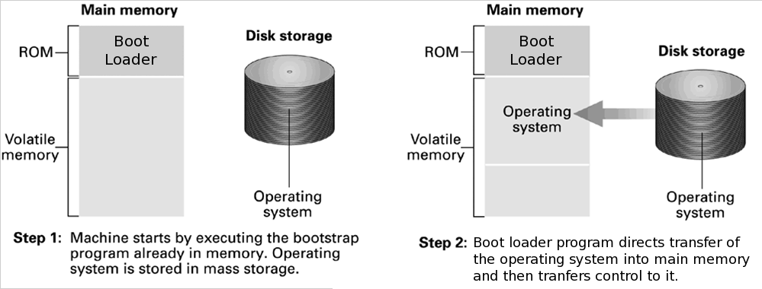
Figure 3.5 The booting process
0-<number>

Slide 37
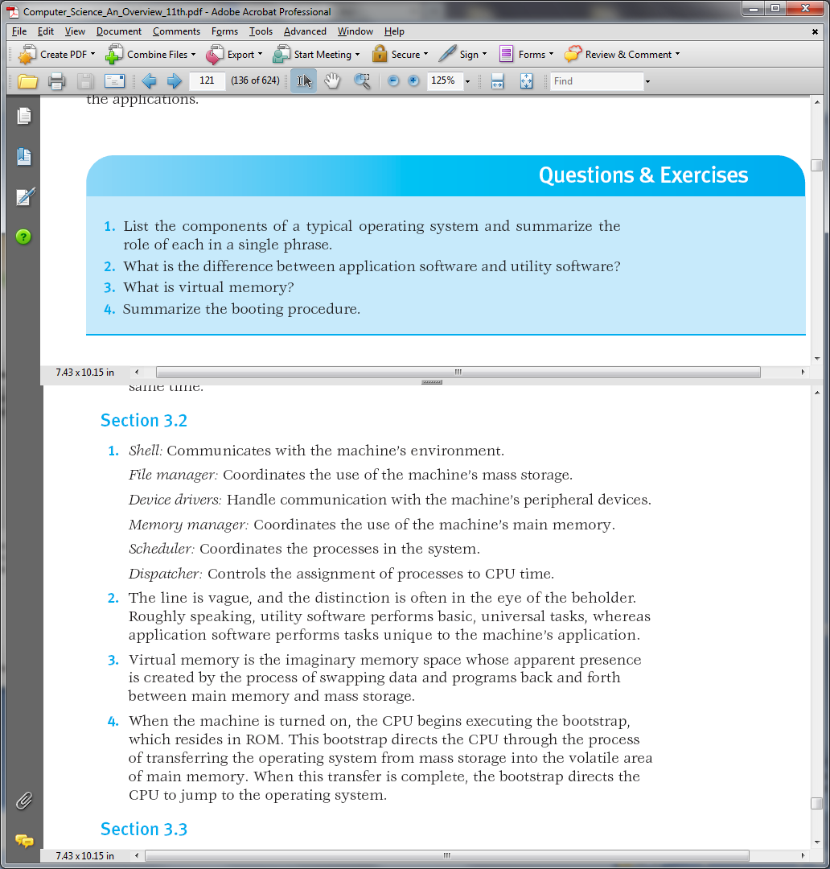
0-<number>

Slide 38
0-<number>

Slide 39
0-<number>

Slide 40
0-<number>

Slide 41
0-<number>

Slide 42
Coordinating the Machine’s Activities
In this section we consider how an operating system coordinates the execution of application software, utility software, and units within the operating system itself.
We begin with the concept of a process.
One of the most fundamental concepts of modern operating systems is the distinction between a program and the activity of executing a program.
The former is a static set of directions, whereas the latter is a dynamic activity whose properties change as time progresses.
0-<number>

Slide 43
Processes
Process: The activity of executing a program under the control of the operating system
Process State: Current status of the activity.
This state includes the current position in the program being executed (the value of the program counter) as well as the values in the other CPU registers and the associated memory cells.
the process state is a snapshot of the machine at a particular time.
0-<number>

Slide 44
Processes
typical time-sharing/multitasking computers are running many processes, all competing for the computer’s resources.
It is the task of the operating system to manage these processes so that each process has the resources (peripheral devices, space in main memory, access to files, and access to a CPU) that it needs, that independent processes do not interfere with one another, and that processes that need to exchange information are able to do so.
0-<number>

Slide 45
Process Administration
The tasks associated with coordinating the execution of processes are handled by the scheduler and dispatcher within the operating system’s kernel.
The scheduler maintains a record of the processes present in the computer system, introduces new processes to this pool, and removes completed processes from the pool.
Thus when a user requests the execution of an application, it is the scheduler that adds the execution of that application to the pool of current processes.
0-<number>

Slide 46
Process Administration
To keep track of all the processes, the scheduler maintains a block of information in main memory called the process table.
Each time the execution of a program is requested, the scheduler creates a new entry for that process in the process table.
This entry contains such information as the memory area assigned to the process (obtained from the memory manager), the priority of the process, and whether the process is ready or waiting.
0-<number>

Slide 47
Process Administration
A process is ready if it is in a state in which its progress can continue; it is waiting if its progress is currently delayed until some external event occurs, such as the completion of a mass storage operation, the pressing of a key at the keyboard, or the arrival of a message from another process.
0-<number>

Slide 48
Process Administration
Scheduler: Adds new processes to the process table and removes completed processes from the process table
Dispatcher: Controls the allocation of time slices to the processes in the process table
  The end of a time slice is signaled by an interrupt.
0-<number>

Slide 49
The dispatcher is the component of the kernel that oversees the execution of the scheduled processes.
In a time-sharing/multitasking system this task is accomplished by multiprogramming; that is, dividing time into short segments, each called a time slice (typically measured in milliseconds or microseconds), and then switching the CPU’s attention among the processes as each is allowed to execute for one time slice (Figure 3.6).
The procedure of changing from one process to another is called a process switch (or a context switch).
0-<number>

Slide 50
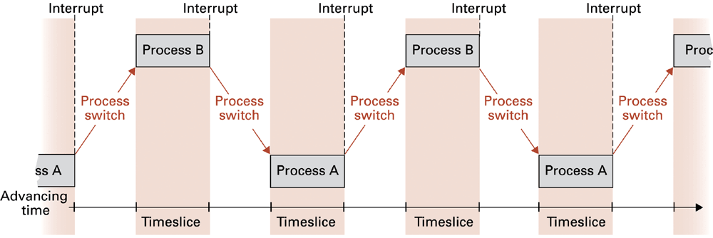
Figure 3.6 Time-sharing between process A and process B
0-<number>

Slide 51
Process Administration
Each time the dispatcher awards a time slice to a process, it initiates a timer circuit that will indicate the end of the slice by generating a signal called an interrupt.
The CPU reacts to this interrupt signal in much the same way that you react when interrupted from a task.
You stop what you are doing, record where you are in the task (so that you will be able to return at a later time), and take care of the interrupting entity.
0-<number>

Slide 52
Process Administration
When the CPU receives an interrupt signal, it completes its current machine cycle, saves its position in the current process and begins executing a program, called an interrupt handler, which is stored at a predetermined location in main memory.
This interrupt handler is a part of the dispatcher, and it describes how the dispatcher should respond to the interrupt signal.
0-<number>

Slide 53
Process Administration
Thus, the effect of the interrupt signal is to preempt the current process and transfer control back to the dispatcher.
At this point, the dispatcher selects the process from the process table that has the highest priority among the ready processes (as determined by the scheduler), restarts the timer circuit, and allows the selected process to begin its time slice.
0-<number>

Slide 54
Process Administration
In the case of a process, the environment that must be re-created is the process’s state, which as already mentioned, includes the value of the program counter as well as the contents of the registers and pertinent memory cells.
CPUs designed for multiprogramming systems incorporate the task of saving this information as part of the CPU’s reaction to the interrupt signal.
0-<number>

Slide 55
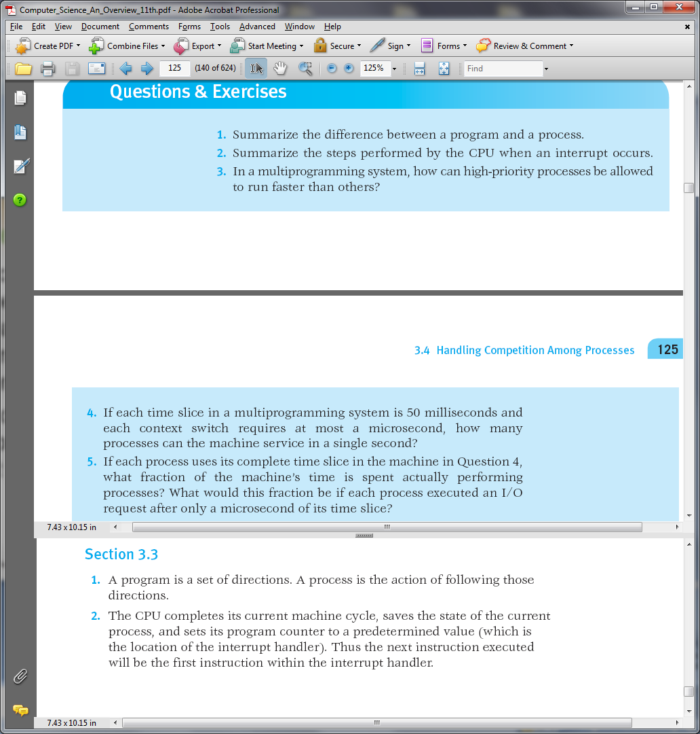
0-<number>

Slide 56
0-<number>

Slide 57
0-<number>

Slide 58
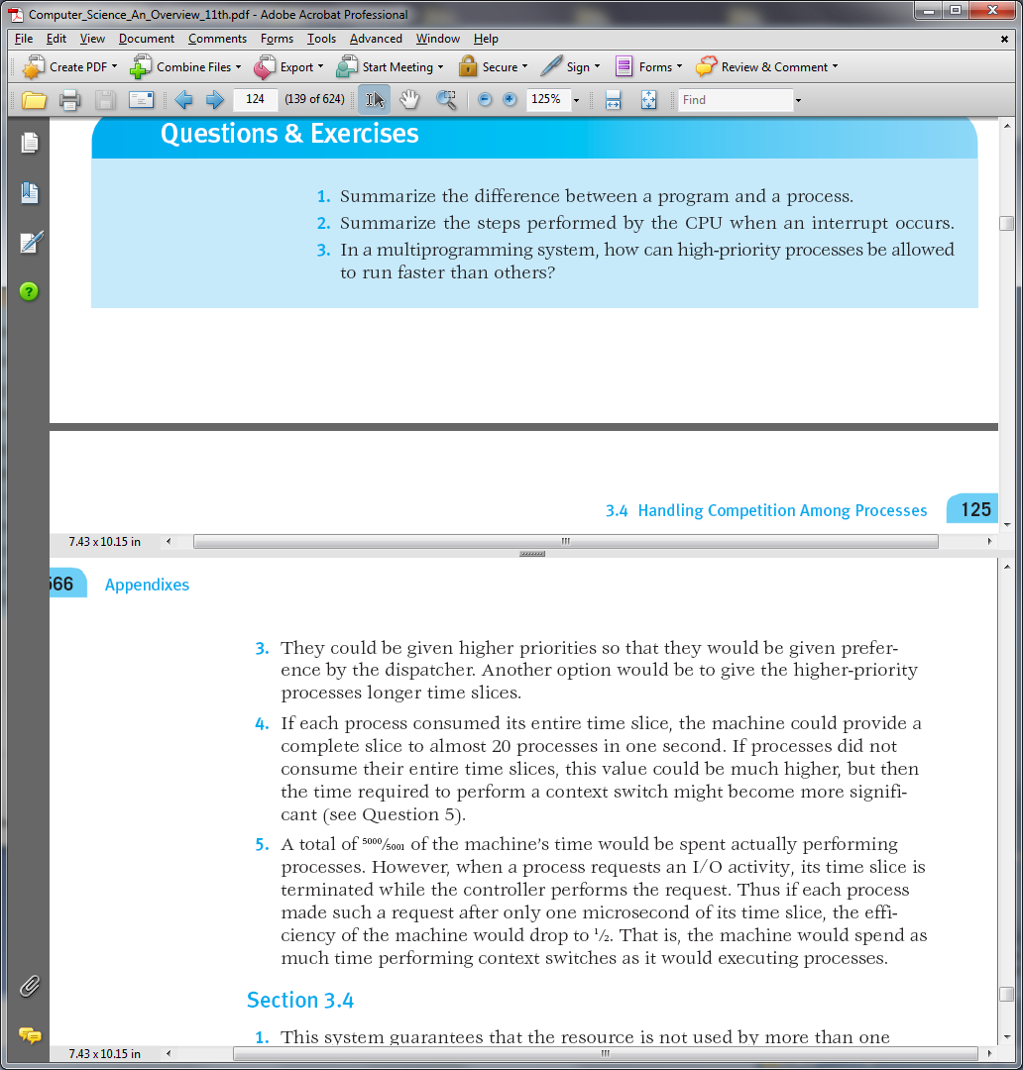
0-<number>

Slide 59
0-<number>

Slide 60
Handling Competition for Resources
An important task of an operating system is the allocation of the machine’s resources to the processes in the system.
Here we are using the term resource in a broad sense, including the machine’s peripheral devices as well as features within the machine itself.
The file manager allocates access to files as well and allocates mass storage space for the construction of new files; the memory manager
allocates memory space;
0-<number>

Slide 61
Handling Competition for Resources
the scheduler allocates space in the process table; and the dispatcher allocates time slices.
Let us consider a time-sharing/multitasking operating system controlling the activities of a computer with a single printer.
If a process needs to print its results, it must request that the operating system give it access to the printer’s device driver.
At this point, the operating system must decide whether to grant this request, depending on whether the printer is already being used by another process. If it is not, the operating system should grant the request and allow the
process to continue; otherwise, the operating system should deny the request
0-<number>

Slide 62
Handling Competition for Resources
If it is not, the operating system should grant the request and allow the process to continue; otherwise, the operating system should deny the request and perhaps classify the process as a waiting process until the printer becomes available.
After all, if two processes were given simultaneous access to the computer’s printer, the results would be worthless to both.
To control access to the printer, the operating system must keep track of whether the printer has been allocated.
0-<number>

Slide 63
Handling Competition for Resources
A properly implemented flag, as just described, is called a semaphore, in reference to the railroad signals used to control access to sections of track.
In fact, semaphores are used in software systems in much the same way as they are in railway systems.
Corresponding to the section of track that can contain only one train at a time is a sequence of instructions that should be executed by only one process at a time. Such a sequence of instructions is called a critical region.
The requirement that only one process at a time be allowed to execute a critical
region is known as mutual exclusion. In summary, a common way of obtaining
mutual exclusion to a critical region is to guard the critical region with a semaphore.
To enter the critical region, a process must find the semaphore clear and
then set the semaphore before entering the critical region; then upon exiting the
critical region, the process must clear the semaphore. If the semaphore is found
in its set state, the process trying to enter the critical region must wait until the
semaphore has been cleared.
0-<number>

Slide 64
The requirement that only one process at a time be allowed to execute a critical region is known as mutual exclusion.
To obtain mutual exclusion to a critical region is to guard the critical region with a semaphore.
To enter the critical region, a process must find the semaphore clear and then set the semaphore before entering the critical region; then upon exiting the critical region, the process must clear the semaphore.
If the semaphore is found in its set state, the process trying to enter the critical region must wait until the semaphore has been cleared.
0-<number>

Slide 65
Handling Competition for Resources
Semaphore: A “control flag”
Critical Region: A group of instructions that should be executed by only one process at a time
Mutual exclusion: Requirement for proper implementation of a critical region
0-<number>

Slide 66
Deadlock
Another problem that can arise during resource allocation is deadlock, the condition in which two or more processes are blocked from progressing because each is waiting for a resource that is allocated to another.
For example, one process may have access to the computer’s printer but be waiting for access to the computer’s CD player, while another process has access to the CD player but
is waiting for the printer.
0-<number>

Slide 67
Deadlock
Analysis of deadlock has revealed that it cannot occur unless all three of the following conditions are satisfied:
1. There is competition for nonshareable resources.
2. The resources are requested on a partial basis; that is, having received some resources, a process will return later to request more.
3. Once a resource has been allocated, it cannot be forcibly retrieved.
0-<number>

Slide 68
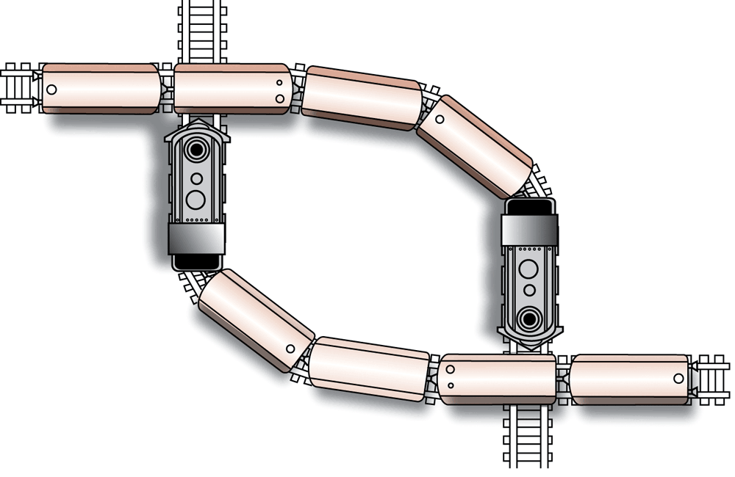
Figure 3.7 A deadlock resulting from competition for nonshareable railroad intersections
0-<number>

Slide 69
Deadlock
The point of isolating these conditions is that the deadlock problem can be removed by attacking any one of the three.
detect deadlock occur and correct it by forcibly retrieving some of the allocated resources.
Example of a full process table might fall in this class. If deadlock should occur due to a full table, routines within the operating system can remove (kill) some of the processes.
This releases space in the process table, breaking the deadlock and allowing the remaining processes to continue their tasks.
0-<number>

Slide 70
Security
Attacks from outside
  Problems
    Insecure passwords
    Sniffing software (records activities and later reports them to a would-be intruder. a program that simulates the operating system’s login procedure.)
Auditing software (record and then analyze the activities taking place within the computer system, attempts to login using incorrect passwords, identify activities within a user’s account that do not
conform to that user’s past behavior)
0-<number>

Slide 71
Security (continued)
Attacks from within :
Once an intruder gains access to a computer system, the next step is usually to explore, looking for information of interest or for places to insert destructive software.
To protect against such actions, CPUs for multiprogramming systems are designed to operate in one of two privilege levels; we will call one “privileged mode,” the other we will call “nonprivileged mode.”
0-<number>

Slide 72
Security (continued)
When in privileged mode, the CPU is able to execute all the instructions in its machine language.
However, when in nonprivileged mode, the list of acceptable instructions is limited.
The instructions that are available only in privileged mode are called privileged instructions. (instructions that change the contents of memory limit registers and instructions that change the current privilege mode of the CPU.)
0-<number>

Slide 73
An attempt to execute a privileged instruction when the CPU is in nonprivileged mode causes an interrupt.
This interrupt converts the CPU to privileged mode and transfers control to an interrupt handler within the operating system.
When first turned on, the CPU is in privileged mode. Thus, when the operating system starts at the end of the boot process, all instructions are executable.
However, each time the operating system allows a process to start a time slice, it switches the CPU to nonprivileged mode by executing a “change privilege mode” instruction.
0-<number>

